Slide 1

Athens Drive Magnet High School:
Kickoff to Registration for 2024-2025
January 29, 2025

Slide 2
Registration Overview
We are ready to begin the registration process for our rising 10th, 11th and 12th graders by providing this overview during Drive Time.
Feb-April: Students will be provided individual appointments with their counselor to discuss registration choices and enter them in PowerSchool.
Students will be given the opportunity to make changes to their course registration choices until June 6, 2025.

Slide 3
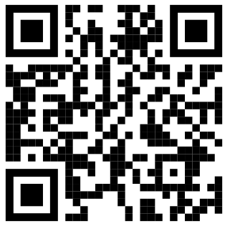
Registration Overview
Individual meetings have been scheduled, either through English classes or appointment times, for students to meet with their alphabet counselor to discuss their registration choices and to enter the selections in PowerSchool.
In order to maximize this meeting time, students should review the course registration materials prior to the meeting and come prepared to discuss their choices with their counselor.
Use the Course Selection Sheet to write down your choices. Bring this form with you to your meeting with your Counselor!
Scan here to see available courses for your grade level!

Slide 4
Registration Overview
To access course registration materials:
Go to the Athens Drive Magnet High School website
Click on “Students” in the header bar
Click on “Student Services” in the drop down menu
Click on “Course Registration” on the left menu
Use the appropriate grade level document to plan for your courses next
school year (each grade level is now on the website)

Slide 5
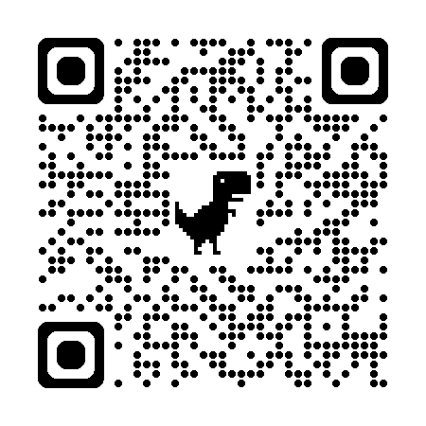
Registration Overview
Meeting Schedule
  Feb 3 - Feb 13: Rising 12th Grade
  Feb 18 - Feb 27: Rising 11th Grade
  Mar 3 - Mar 13: Rising 10th Grade
Where can I find out my meeting date/time?
  Appointment dates/times are posted outside Student Services,on the Student Services website, and each teacher has this information.
Can’t find your name? Email your Counselor!
Registration
Schedule

Slide 6
Registration Overview
Go home and review the registration website with your parents and write down your choices for next year.
Students will choose 11 total courses for their registration choices.
  8 “primary” and 3 “alternate”
Students should be prepared to receive any 8 of their 11 course choices so please make informed decisions.
Mid April - Course Verification Sheets will be sent home to confirm registration choices
Up until June 6, 2025: Students may email their counselor directly if they want to make a change to their course selections. No changes will be made after that date.

Slide 7
Thank you for your attention!

